Slide 1
Spending Tracker
CS430
Cameron Bradley & Jack Duensing

Slide 2
Purpose/Scope
Web application used to track spending
  Self server hosted web app
  Facilitates multiple users
  Provides analysis on spending habits
  A single place for users to keep record of purchase history
Solely a storage, self analysis tool
  Did not want to make another budgeting app
  Focused on storage of purchase history and self analysis

Slide 3
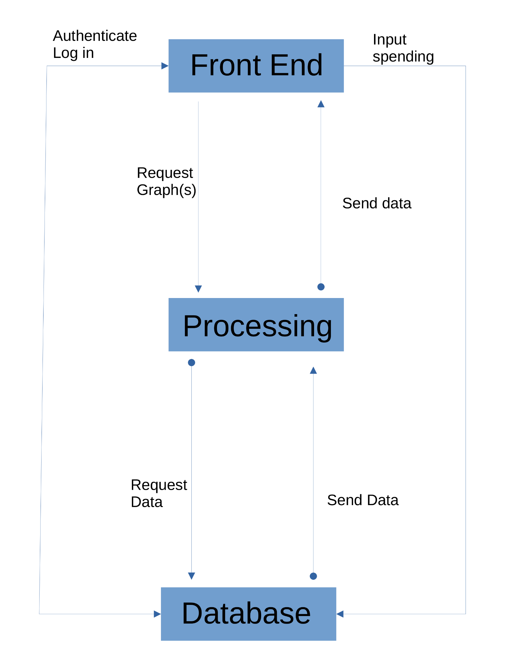
Project Architecture
Server host performs the storage, retrieval, and publishing
  User logs in
  Their userID is captured
  Graph data is collected with SQL
  The graphs are published with plotly to the user
Fully online web application
Tools
  Samba
  Github
  Pandas
  Plotly
  Flask
Tools
  SQLAlchemy
  GeoPy
  Secrets
  Hashlib

Slide 4
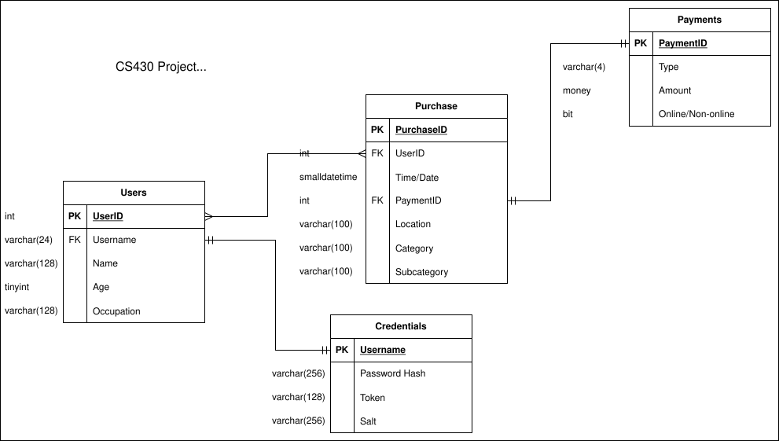
Database Architecture
Microsoft SQL Server 2025
Used ChatGPT to create synthetic data for analysis
  Created 25 users
  Created 1000 purchases

Slide 5
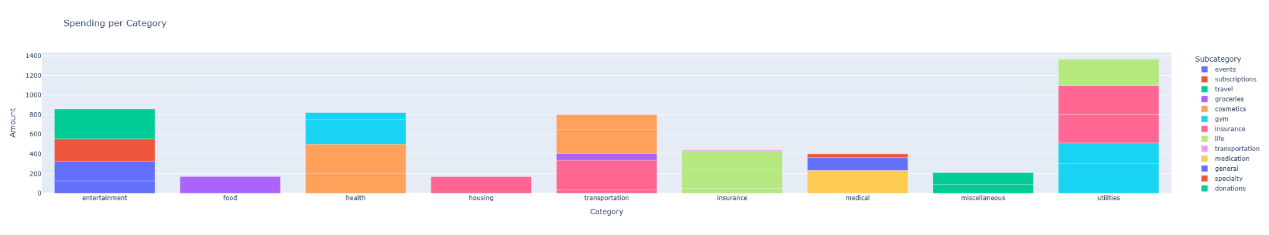
Sample Graphs and Code Showcase
SELECT Purchases.Category, Purchases.Subcategory, Payments.Amount
FROM Purchases
JOIN Payments ON Purchases.PaymentID = Payments.PaymentID
WHERE Purchases.UserID = {userid}
ORDER BY Purchases.Category

Slide 6
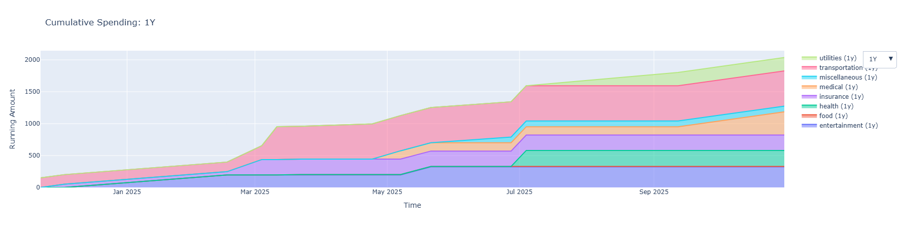
Create the different time frames
For each time frame:
  Slice data
  Generate running total
  Pivot data
  Add trace to plot
Create dropdown that goes between the traces

Slide 7
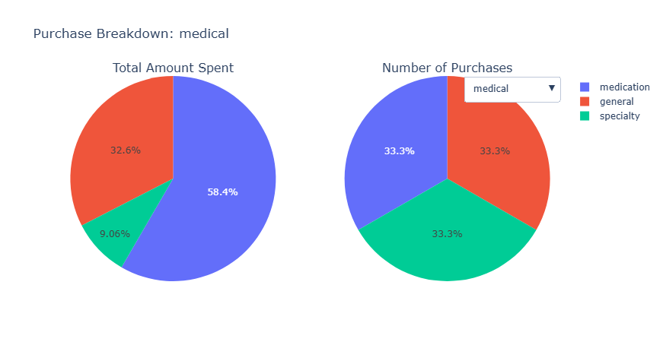
SELECT Purchases.Category, Purchases.Subcategory, Payments.Amount
FROM Purchases
JOIN Payments ON Purchases.PaymentID = Payments.PaymentID
WHERE UserID = {userid}
ORDER BY Purchases.TimeDate
grouped_count = pie_df.groupby(["Category", "Subcategory"]).size().reset_index(name="count")
categories = grouped_count["Category"].unique()
fig = go.Figure()
for i, category in enumerate(categories):
category_df = grouped_count[grouped_count["Category"] == category]
fig.add_trace(
go.Pie(
labels = category_df["Subcategory"],
values = category_df["count"],
name = category,
visible = (i == 0),
hovertemplate = "%{label}, %{value}<extra></extra>"
)
)

Slide 8
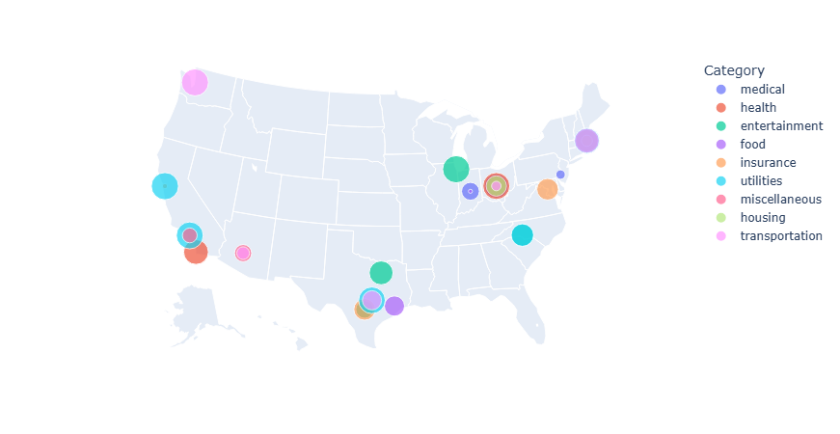
SELECT Purchases.TimeDate, Purchases.Location, Purchases.Category, Payments.Amount
FROM Purchases
JOIN Payments ON Purchases.PaymentID = Payments.PaymentID
JOIN Users ON Purchases.UserID = Users.UserID
WHERE Users.UserID = {userid}
ORDER BY Purchases.TimeDate
lonlat = []
def get_lonlat(location):
index = location.find(',')
city = location[:index]
state = location[-2:]
try:
geolocation = geolocator.geocode(f"{city}, {state}")
return (geolocation.latitude, geolocation.longitude)
except:
return (None, None)
location_df[["latitude", "longitude"]] = location_df["Location"].apply(lambda x: pd.Series(get_lonlat(x)))
fig = px.scatter_geo(location_df, lat = "latitude", lon = "longitude", color = "Category", size = "Amount", projection = 'albers usa')

